Slide 1
Project 3: Exploratory Data Analysis (EDA) for Real Estate Pricing: Unveiling the Dynamics of House Valuation in a Dynamic Market
Submitted TO - NextHikes IT Solutions
Submitted by- RAJBIR KAUR

Slide 2
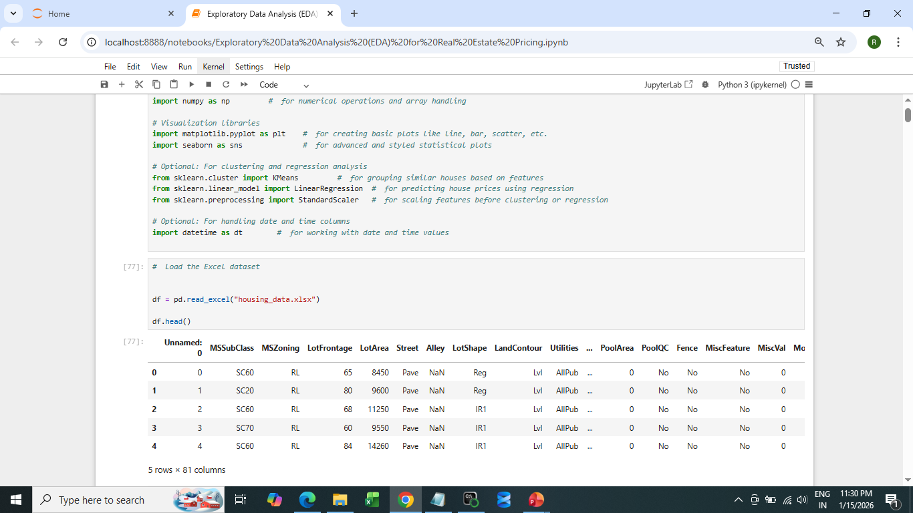
Dataset loaded and cleaned.

Slide 3
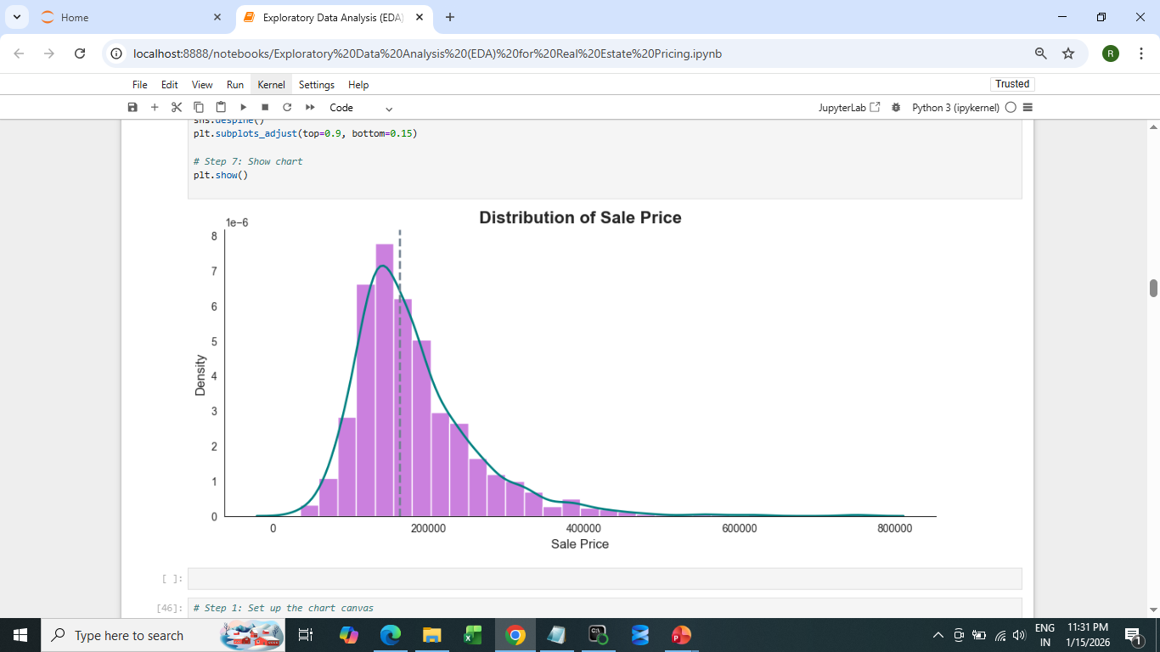
Univariate Analysis

Slide 4
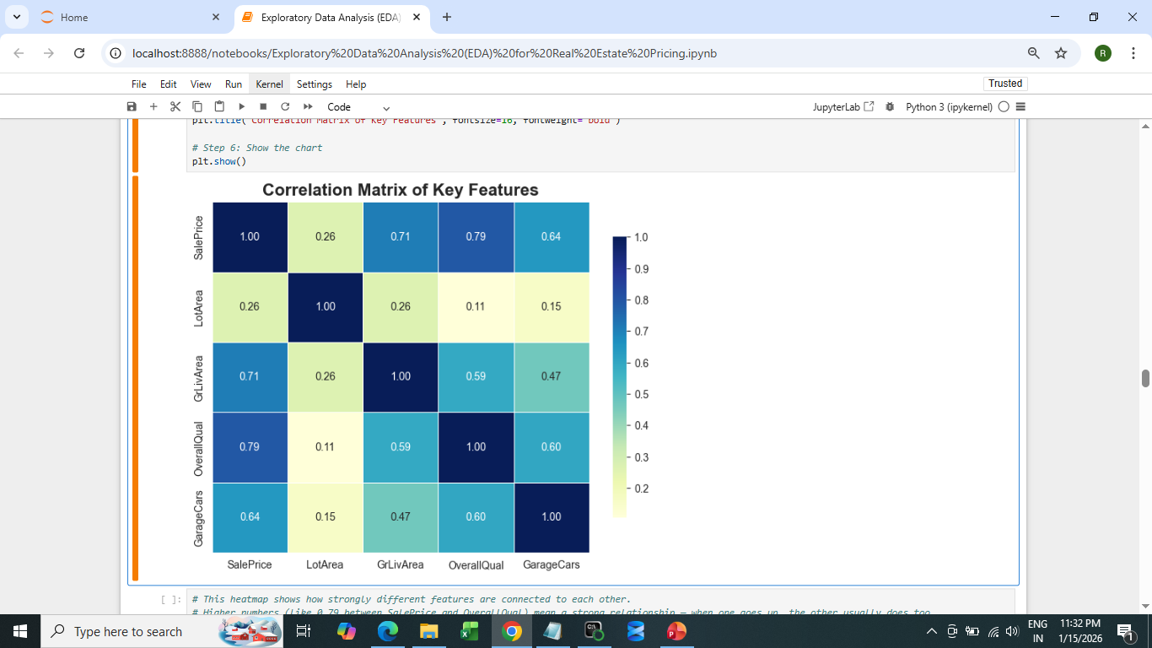
Multivariate Analysis

Slide 5
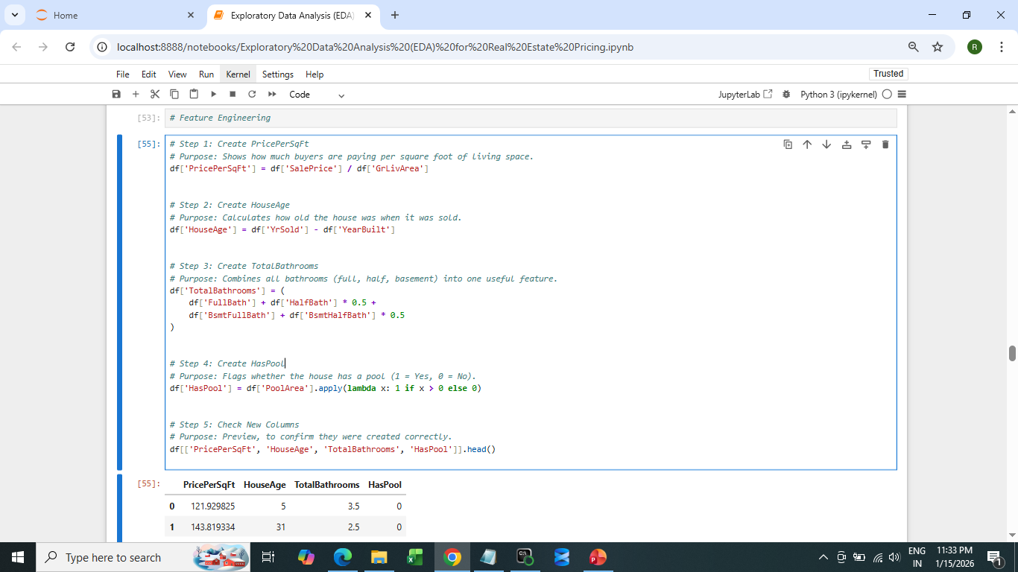
Feature Engineering

Slide 6
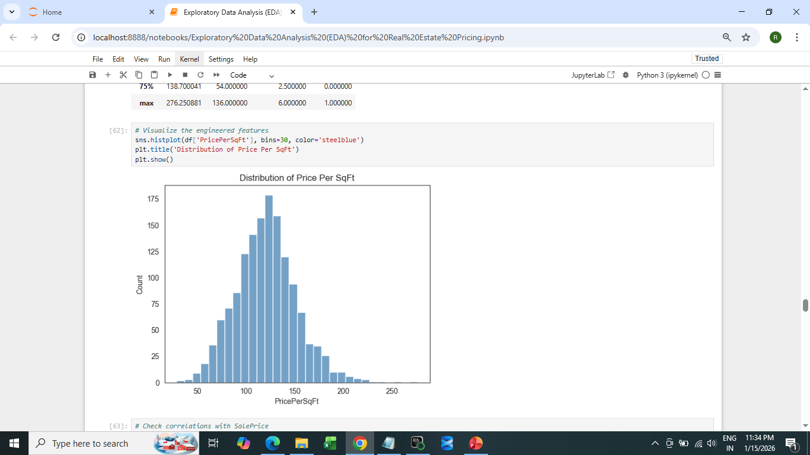
Visualize the engineered features

Slide 7
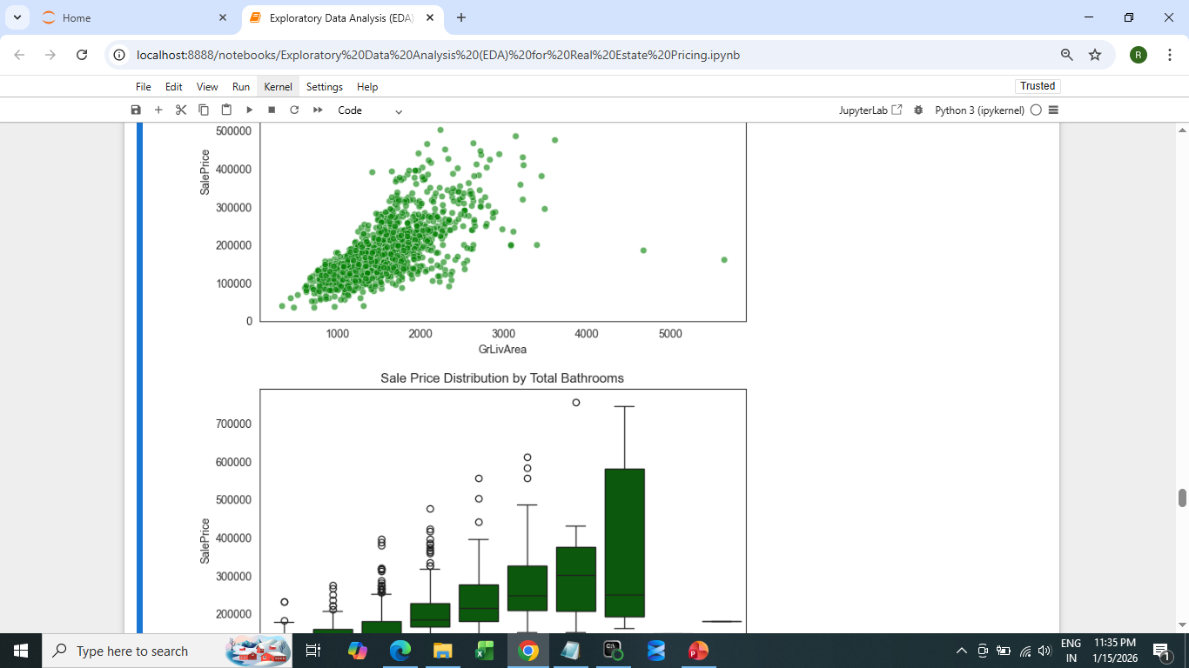
Feature Engineering and Size Impact

Slide 8
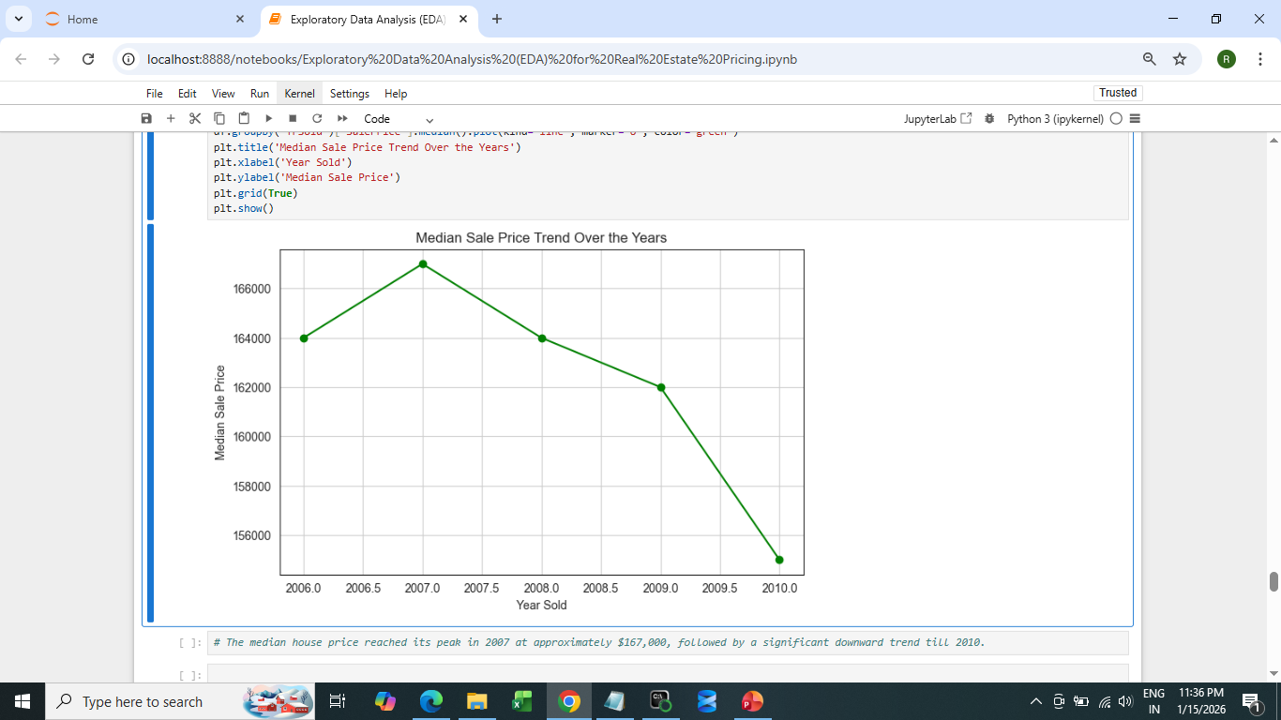
Market Trends and Historical Pricing

Slide 9
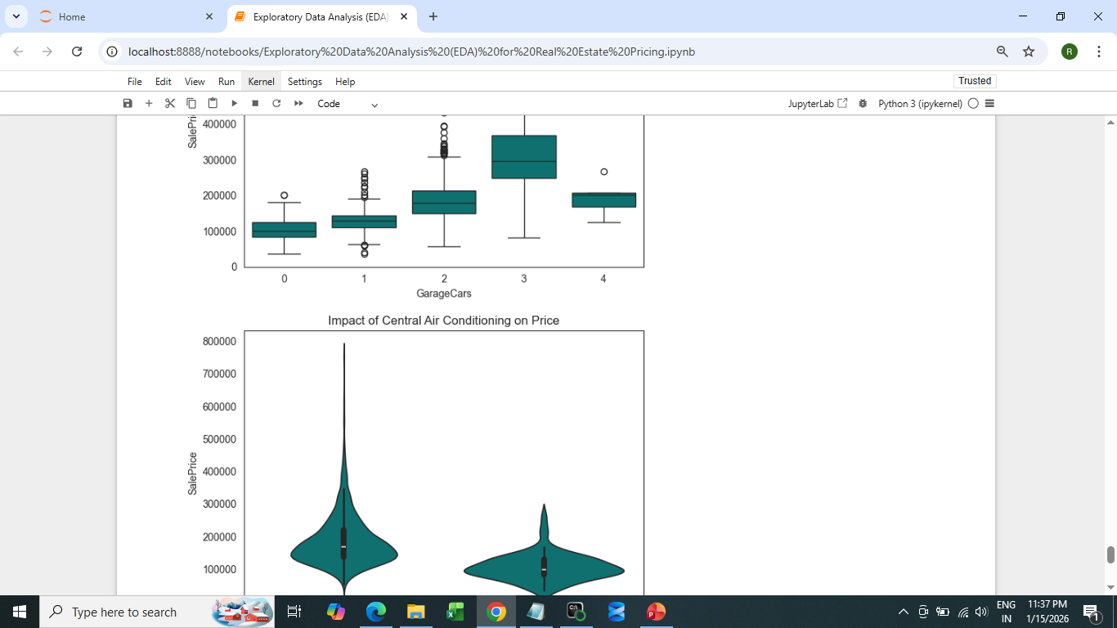
Customer Preferences and Amenities

Slide 10
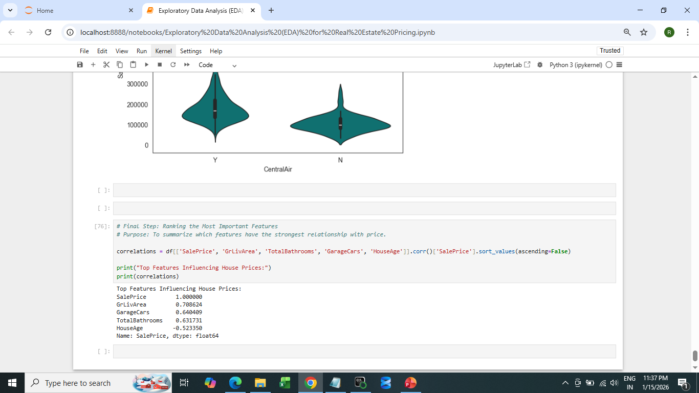
Final step

Slide 11
Final Project Summary
Primary Value Driver: Square footage (GrLivArea) is the most significant predictor of house price.
Key Amenities: Modern comforts like Central Air and larger Garages (specifically 2-3 car capacity) create a noticeable price premium.
Historical Context: The data reflects a market downturn after 2007, showing that even good houses were affected by the broader economic climate of 2008-2010.
Newer is Better: There is a clear trend where younger houses (HouseAge) command higher sale prices.

Slide 12
REFERENCES
GOOGLE OR CHROME
YOUTUBE

Slide 13
THANK YOU

